Slide 1

ROYAL CYBER × COMMERCETOOLS
Royal Cyber
Introductions, Capabilities,
and Experience
Transforming Enterprise Digital Experiences Through Innovation and Expertise
August 2026
Copyright © 2026 Royal Cyber. All rights reserved.
1

Slide 2


















Royal Cyber Overview
IT Consulting & Digital Transformation Company, specializing in Services, Solutions and Software
Saudi Arabia
Canada
USA*
UK
Pakistan*
India*
Mexico
Egypt
Australia
South Africa
New Zealand
20+
2000+
450+
3
11
600+
ISO
Years of
Experience
Employees
Globally
Certified
Consultants
Innovation
centers*
Offices Operating
Globally
Clients Across
the Globe
ISO 9001: 2015 certified
Notes:
Royal Cyber is a global IT consultant and digital transformation company with over 20 years of experience. We have over 2000 employees worldwide and more than 450 certified consultants. As well as delivery teams operating across Europe, North America, the Middle East and APAC. We support more than 600 clients currently globally and I will also share which customers we have worked with in the commercetools space. But this global footprint actually allows us to support enterprise scale initiatives with both speed and scalability.

Slide 3

Key Differentiators
commercetools Practice
B2B/B2C Business Knowledge
Focus
Experienced domain experts with in-depth understanding of B2B/B2C Ecommerce trends across +12 industries
Increased efficiency and consistency by using reusable components
Experts in ecommerce architectural patterns and UX/UI design
Royal Cyber focuses on building futuristic and innovative businesses powered by commercetools, delivering agility, insight, and efficiency across every sector. We are experts in Green Field Implementation, B2B and B2C Implementation, Microservices, Frontastic, Cloud Migration, Support and Enhancement, Composable Commerce, CMS, Search, Headless, Performance Tuning, Managed Service Support, and Regional and Global Roll-outs.
Practice Overview
Customers
Delivery Excellence
Working with commercetools since 2019, with 75+ resources, 30+ Certified Consultants
commercetools configuration and implementation
Composable commerce implementations (CoCo)
Frontastic implementation (CoFe)
Managed services
Solution / extension build
Performance & quality enhancements
JSW – APAC
Breville – NA and ANZ
Rich Products – NA
Dr. Reddy's Lab – NA, German, APAC
Sportsman's Guide – NA
MARS – NA
GWA – ANZ
Nerivio – German
Wildfork – NA
Abbott Labs – NA
Beckett Collectible – NA
Strong experience in program governance, risk management and project schedules
On-time delivery track record
Code reviews per standard technology guidelines, with SonarQube quality checks
RC Innovation Advantage
Free RC-built Accelerator that integrates easily with commerce platforms
Dev environment integrated with RC-built testing tool – GTP
Summary of Experience
Commercetools B2B/B2C Implementation
Large Delivery Team
Strong North American Presence
Established Partnership
Deep Commerce Expertise
We Build Innovation
Several implementations for some of the largest global and national brands
75+ commercetools resources, of which 30+ are certified around the globe
10+ commercetools resources in the U.S.
commercetools Silver Partner
4 delivery centers worldwide: U.S., India, Canada and Pakistan
Several Royal Cyber solutions enabling clients to compete with an edge
3
Copyright © 2026 Royal Cyber. All rights reserved.

Slide 4
SUCCESS STORIES
Core Features Driving Customer Transformation
4
Copyright © 2026 Royal Cyber. All rights reserved.

Slide 5
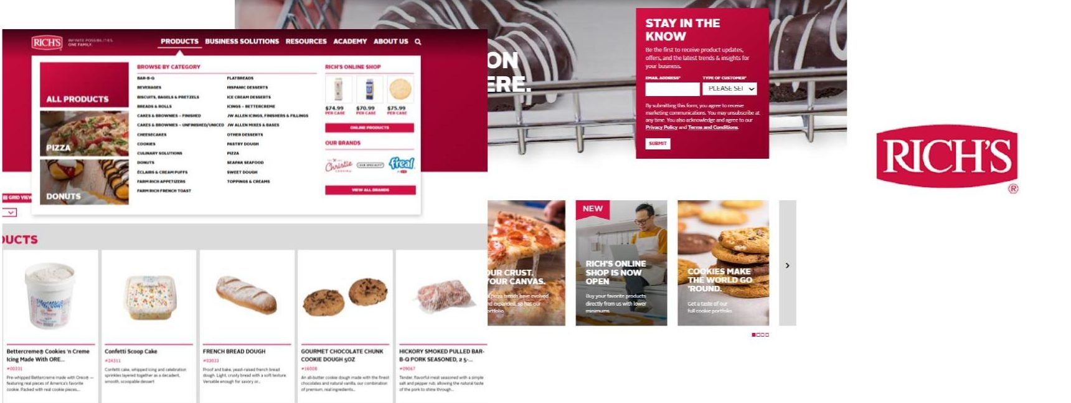
KEY FEATURES
Composable Architecture (D2C Model): Enabled Rich’s to break free from monolithic constraints, scaling rapidly across products, regions, and business units.
Faster Time-to-Market: Reduced deployment cycles for new features and offerings, enabling quicker adaptation to market demands.
Corporate Gifting (B2B Model): Built a self-service portal where customers now can manage gifting orders and receive updates.
Streamlined PIM: Centralized product data into a unified platform, reducing duplication and ensuring consistency across channels.
Rich’s USA
Scalable, Efficient, and Customer-Centric Commerce
Website: Rich's USA | Foodservice & In-Store Bakery Food Supplier
5
Copyright © 2026 Royal Cyber. All rights reserved.
Notes:
provides bakery, dessert, and culinary products to restaurants, retailers, and foodservice providers​
B2B​
For Rich’s, Royal Cyber helped modernize their platform to be faster, more scalable, and more consistent. We centralized product information into a single platform, cutting down on duplication and ensuring data is accurate across all channels. By implementing a composable architecture, we helped Rich’s break free from monolithic constraints, so the platform can scale easily across products, regions, and business units. And with faster deployment cycles, they can bring new features and offerings to market more quickly, staying ahead of customer needs.​

Slide 6
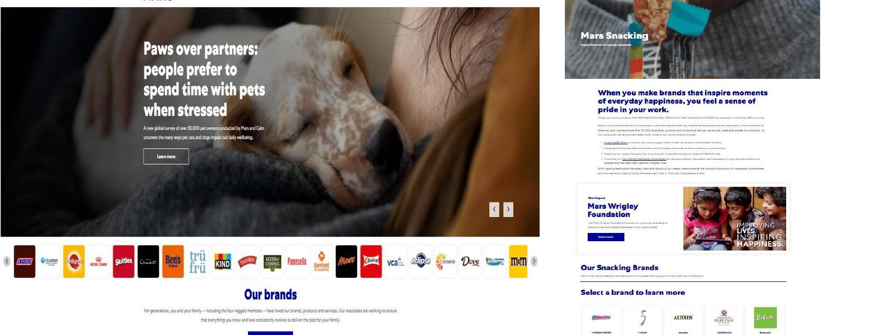
KEY FEATURES
Enhanced Personalization: Integrated capabilities for customizable products, such as personalized M&M's, improving engagement and satisfaction.
Streamlined Catalog Management: Efficient management of product catalogs, enabling quicker updates and consistency across channels.
Multibrand Enablement: Centralized management of multiple Mars brands on one platform, preserving brand identity while accelerating time-to-market.
Mars
Personalization, Multibrand Management & Catalog Optimization
Website: Global Petcare, Food & Nutrition, and Snacking Brands | Mars, Incorporated
6
Copyright © 2026 Royal Cyber. All rights reserved.
Notes:
known for producing popular confectionery brands like M&M's, Snickers, and Twix​
D2C​
For Mars, Royal Cyber helped make the digital experience more engaging and efficient. We added enhanced personalization, like customizable M&M’s, to boost customer satisfaction and interaction. On the backend, we streamlined catalog management, making it easier to keep product information consistent and up to date across all channels. And we enabled multibrand management, so multiple Mars brands could be handled on a single platform — keeping each brand’s unique identity while speeding up operations and time-to-marke​

Slide 7
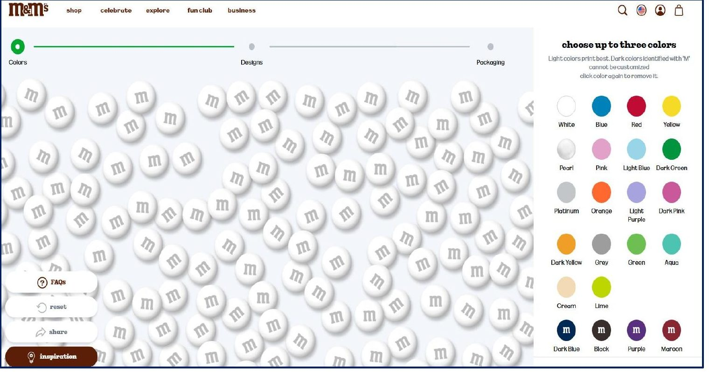
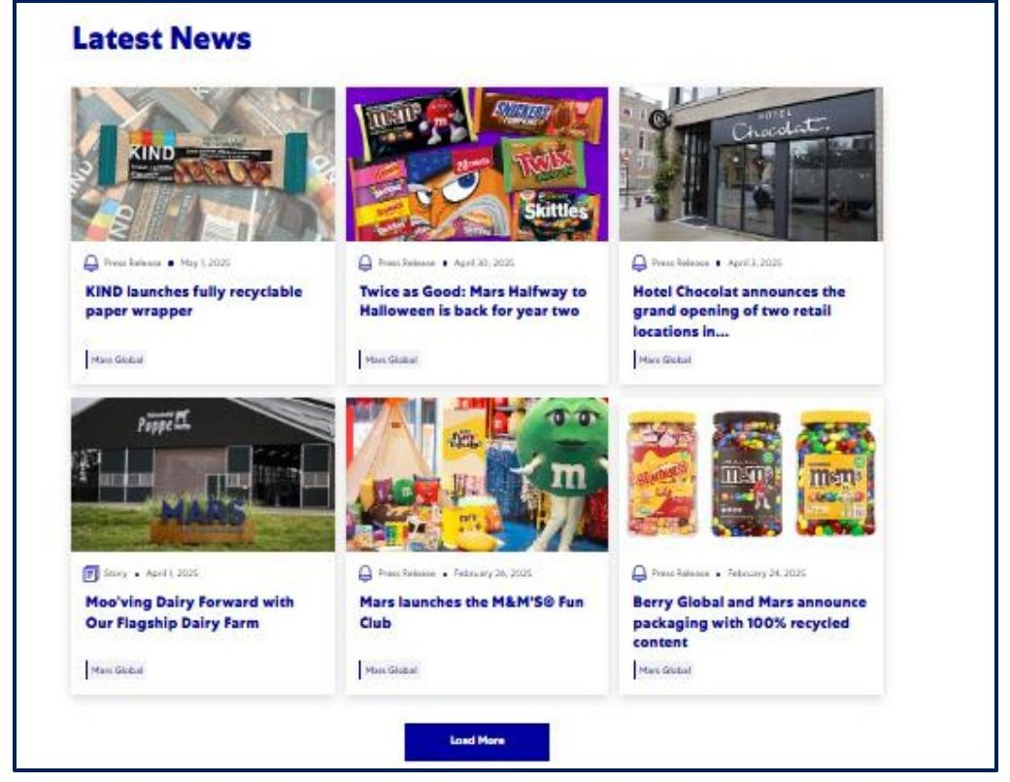
Mars D2C Experience
Features That Power Personalization & Scale
Create Your M&M's Feature
Latest News Feature
Brands Powered on the Platform
7
Copyright © 2026 Royal Cyber. All rights reserved.

Slide 8
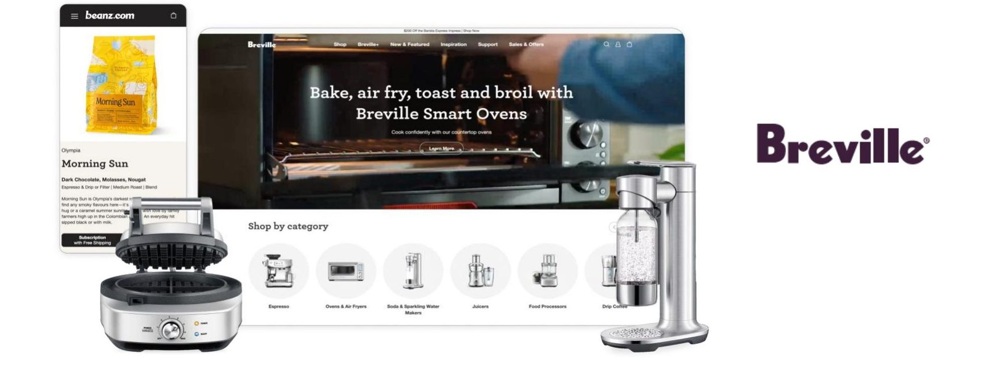
KEY FEATURES
Product Bundling & Subscriptions: Flexible bundling and subscription options, combining one-time purchases with recurring subscriptions in a single checkout.
Cross-Brand Promotions: Integrated Voucherify with commercetools via API extensions to manage complex, cross-brand promotional campaigns.
Personalized Experiences: Features like the “coffee quiz” on Beanz.com deliver tailored product recommendations based on taste profiles.
Breville
API-Driven Bundles, Subscriptions & Personalization
Website: Breville Commercial – beanz.com | Coffee Subscription & Delivery
8
Copyright © 2026 Royal Cyber. All rights reserved.
Notes:
Breville Group Limited is an Australian multinational company specializing in the design, development, and marketing of small kitchen appliances, including espresso machines, blenders, toasters, and ovens. B2C, We focused on making the customer experience smarter and more flexible. We implemented advanced product bundling and subscription options, so customers can mix one-time purchases with recurring subscriptions all in a single checkout. We also integrated Voucherify with commercetools to run complex, cross-brand promotions — for example, offering coffee bean discounts when you buy a coffee machine. And to make it truly personalized, we added features like the ‘coffee quiz’ on Beanz.com, giving tailored product recommendations based on each customer’s taste profil​

Slide 9
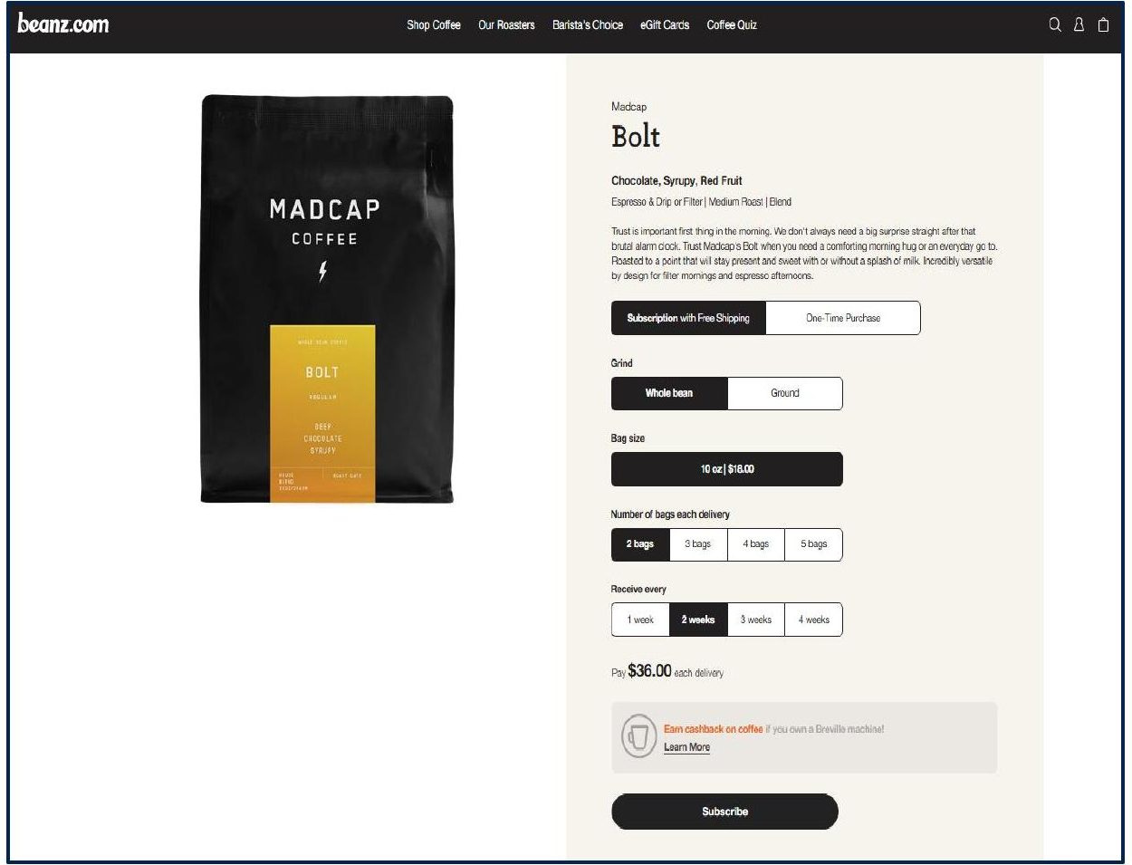
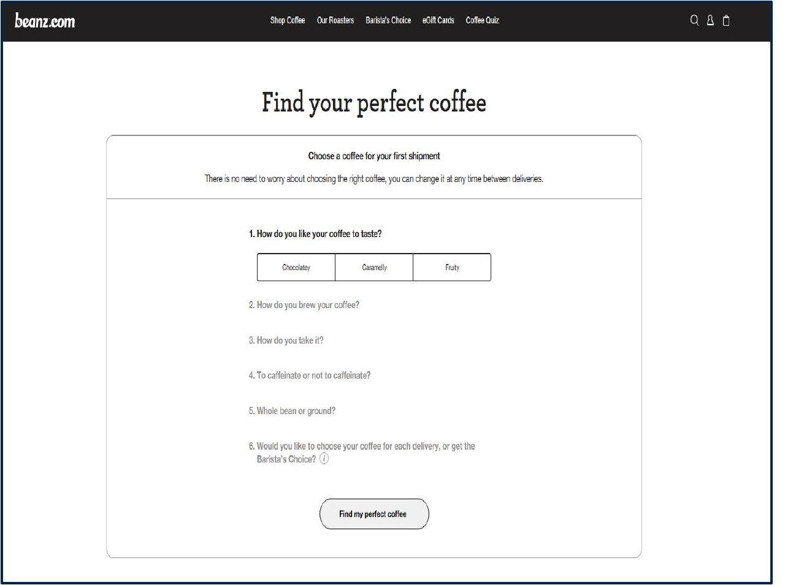
Breville Website Features
Customizable Beans Subscription
Personalized Coffee Selection Quiz
9
ROYAL CYBER × commercetools
Copyright © 2026 Royal Cyber. All rights reserved.

Slide 10
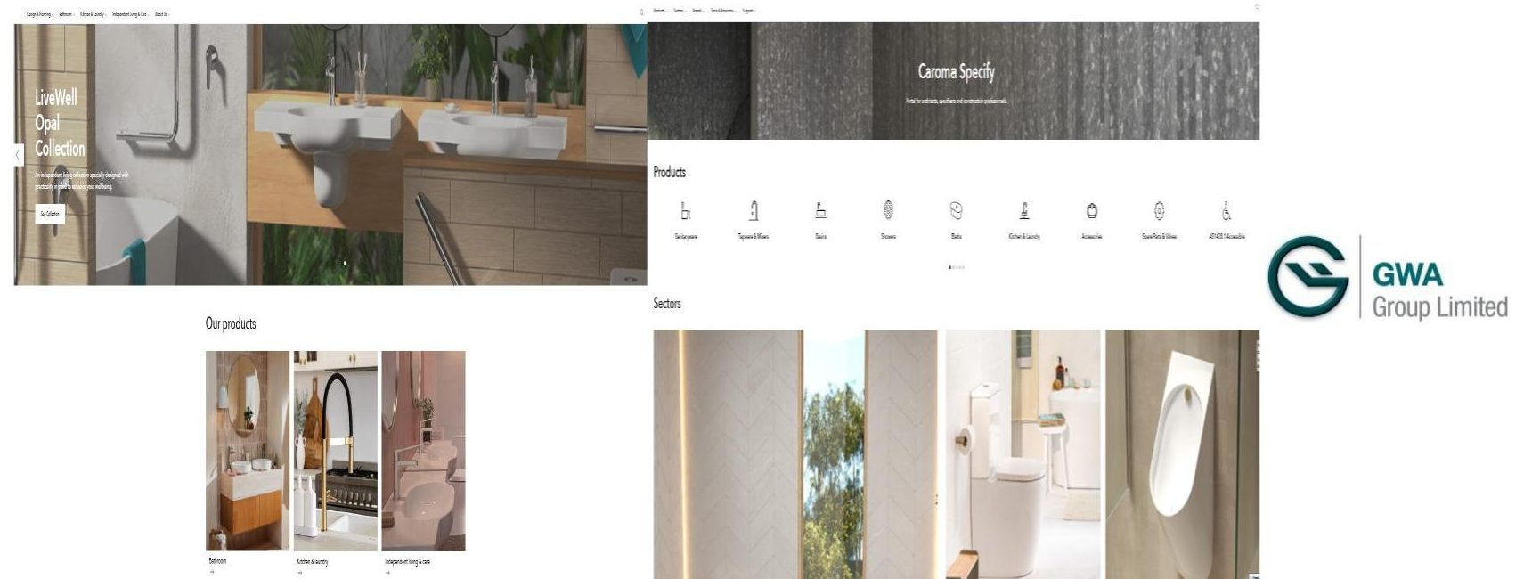
KEY FEATURES
Self-Service Merchant Portal: Centralized B2B platform for merchants to manage orders, access pricing, and track inventory without sales reps.
Composable Multi-Brand CMS: Unified content system for managing multiple brand sites, preserving identities and reducing time-to-market.
Dynamic Price Toggling: Real-time switching between customer-specific, tiered, and promotional pricing based on user type and status.
GWA
Unified, Intelligent, and Merchant-Driven Digital Experience
Website: Caroma Made For Life AU / Caroma Specify Australia
11
Copyright © 2026 Royal Cyber. All rights reserved.
Notes:
GWA Group Limited, a leading Australian supplier of sustainable water solutions and supplies for bathrooms, kitchens, and laundries.​
​
For GWA, Royal Cyber helped empower merchants with more control and flexibility. We built a self-service B2B portal where merchants can manage orders, access personalized pricing, and track inventory in real time — all without relying on sales reps. We also implemented a composable multi-brand CMS to streamline updates across multiple brand sites while preserving each brand’s identity. And to enhance transparency and personalization, we enabled dynamic price toggling, so merchants see customer-specific, tiered, or promotional pricing based on their profile and purchase volume​

Slide 11
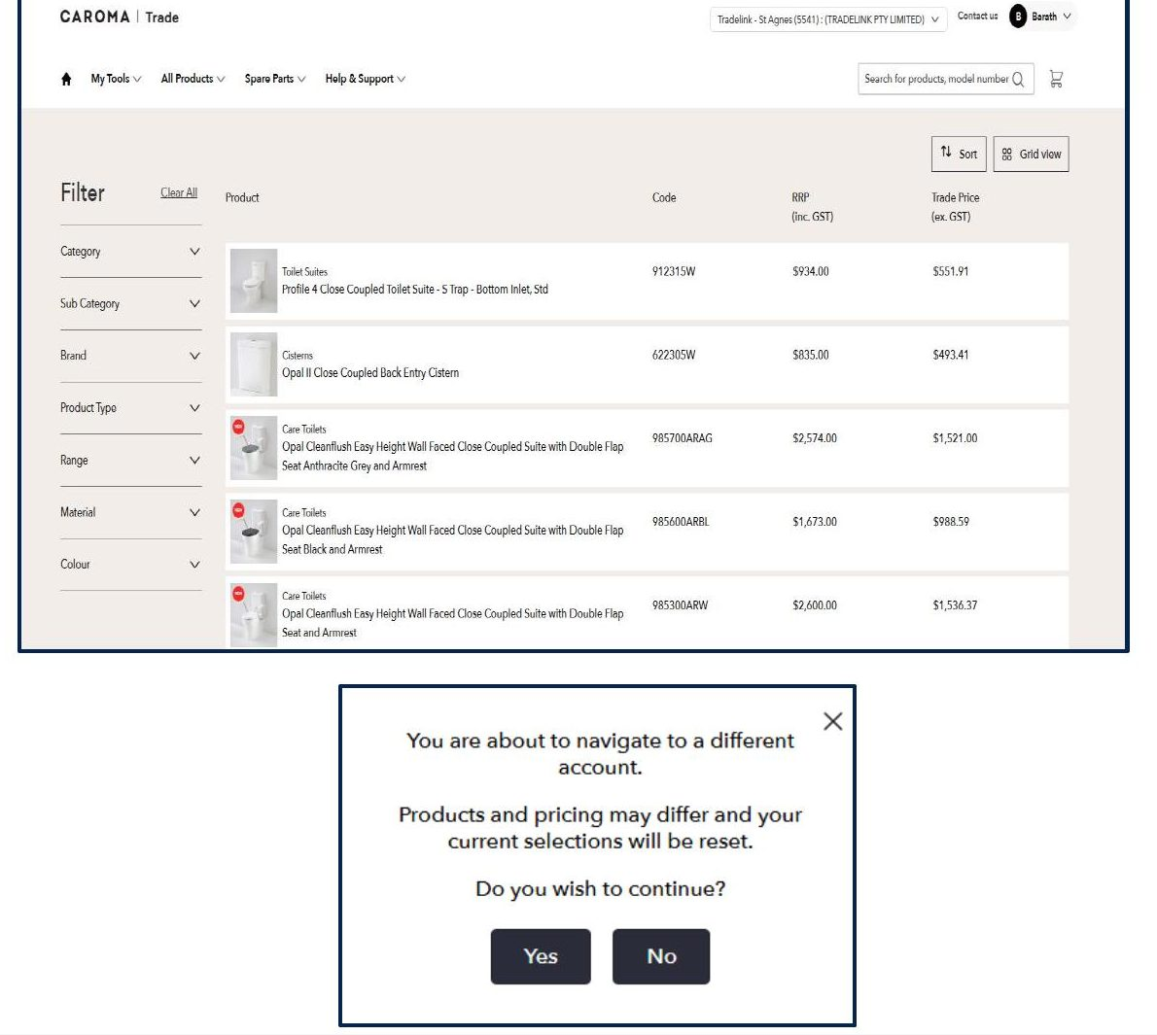
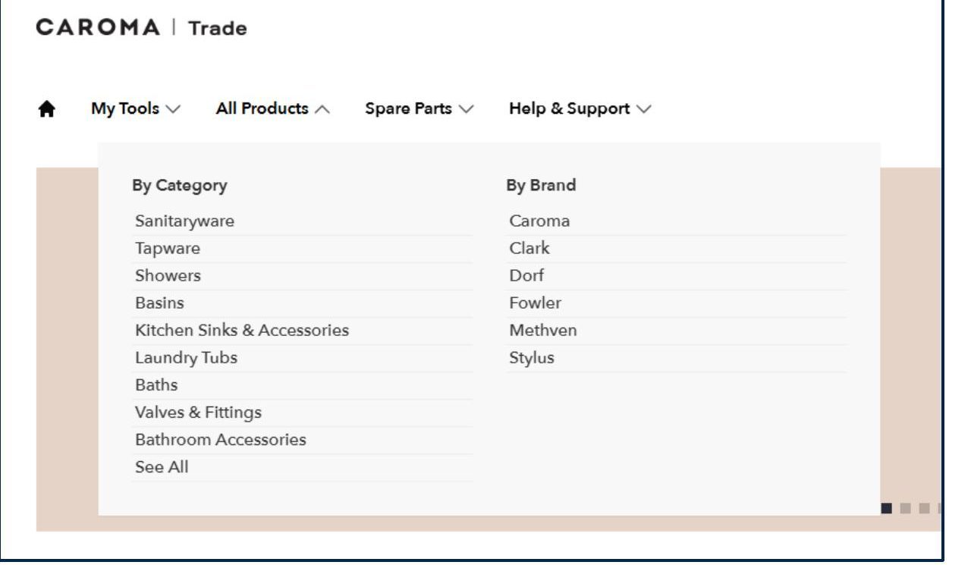
GWA Digital Experience Highlights
Dynamic Pricing and Product View
Streamlined Multibrand Content Mgmt
Copyright © 2026 Royal Cyber. All rights reserved.
12

Slide 12
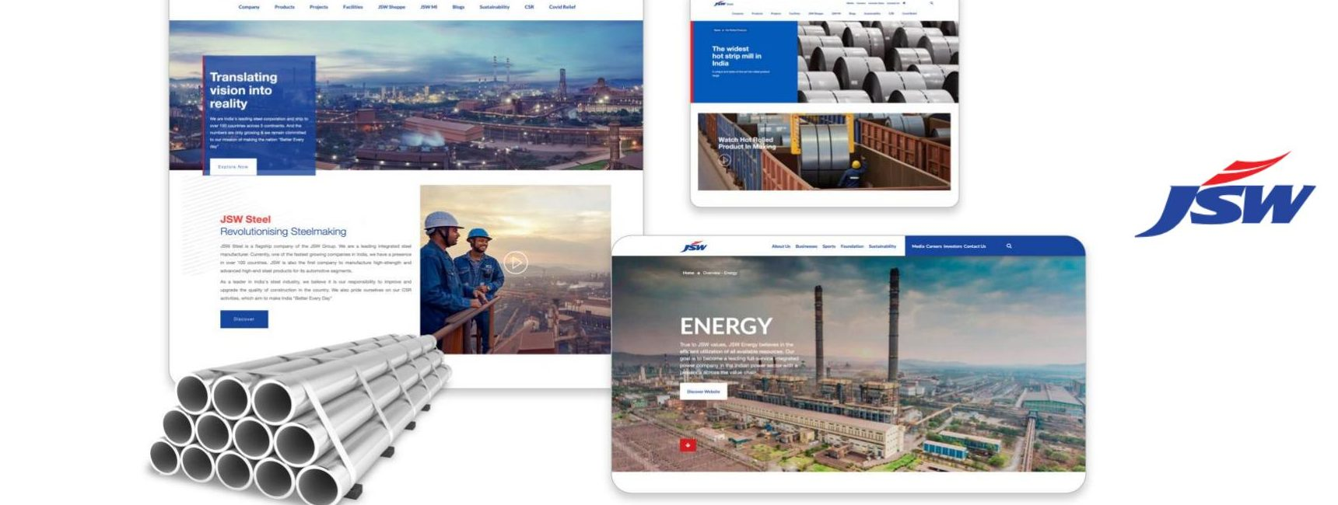
KEY FEATURES
Configurable Product Variants: Enabled management of complex steel product configurations by weight, grade, and length.
Dynamic Pricing Models: Flexible pricing strategies tailored to customer segments and order volumes.
Omnichannel B2B/B2B2C + AI: Unified marketplace for distributors and retailers, with AI/ML-driven personalized recommendations.
JSW One
Modern Commerce Solutions by Royal Cyber
Website: Buy Steel Online | Industrial Materials Marketplace | JSW One MSME
13
Copyright © 2026 Royal Cyber. All rights reserved.
Notes:
JSW Group is a $24 billion Indian multinational conglomerate headquartered in Mumbai, operating across sectors like steel, energy, infrastructure, cement, paints….“ For their B2B platform, Royal Cyber helped simplify a really complex buying experience. We enabled configurable product variants so buyers could select steel by weight, grade, and length. We added dynamic pricing that adjusts by customer type and order volume, and built a unified omnichannel platform for both distributors and retailers. On top of that, AI and machine learning drive personalized product recommendations, making the whole experience smarter and easier for every buyer.”​

Slide 13
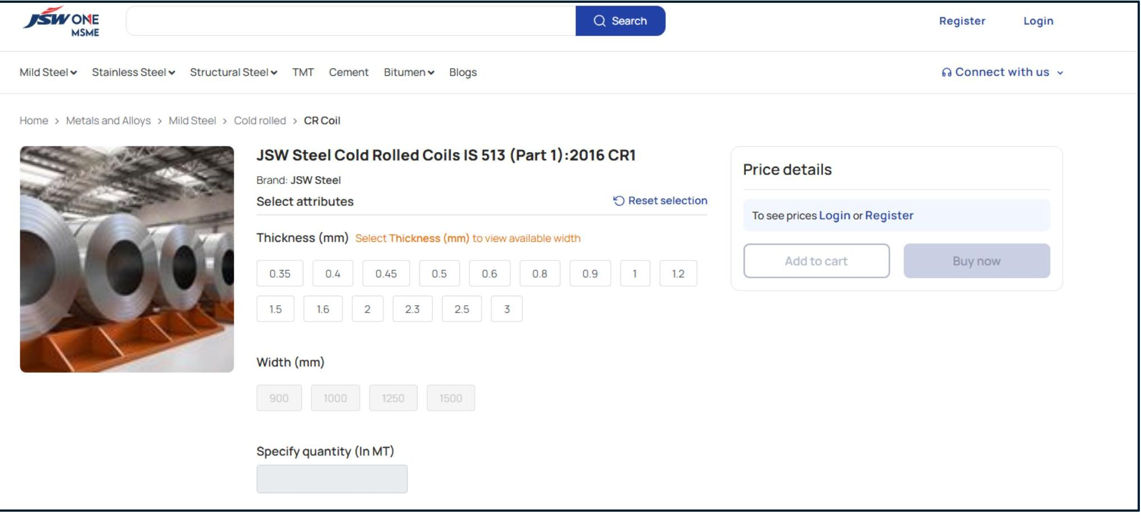
JSW Steel Configurability Feature
14
Copyright © 2026 Royal Cyber. All rights reserved.

Slide 14
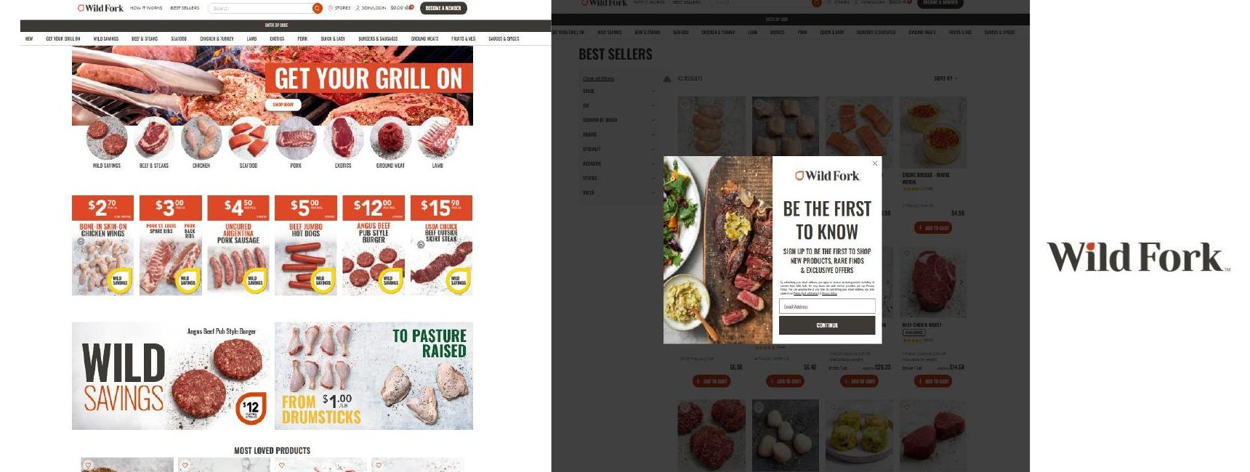
KEY FEATURES
Assisted Service Capability: CS agents securely log in as customers for real-time help with purchases, login issues, or cart abandonment.
Integrated Ticketing: Seamless multichannel support (email, chat, phone) with efficient tracking and resolution under unique IDs.
Fraudulent Order Detection: Smart fraud detection using behavioral analytics cut fraud by 50% in three months and boosted efficiency.
Wild Fork
CSA-Enabled Seamless Support
Website: Meat Online Store | Frozen Meat & Seafood Delivery | Wild Fork Foods
10
Copyright © 2026 Royal Cyber. All rights reserved.
Notes:
Wild Fork is a specialty food retailer focused on delivering high-quality frozen meats and seafood directly to consumers​
​
For WildFork, Royal Cyber focused on improving the customer experience while boosting operational efficiency. We enabled assisted service capabilities, letting CS agents securely log in as customers to help with purchases, login issues, or cart abandonment in real time. We also integrated a multichannel ticketing system to track and resolve customer issues efficiently across email, chat, and phone. On top of that, we deployed smart fraud detection using behavioral analytics, which cut fraudulent orders by 50% in just three months​

Slide 15
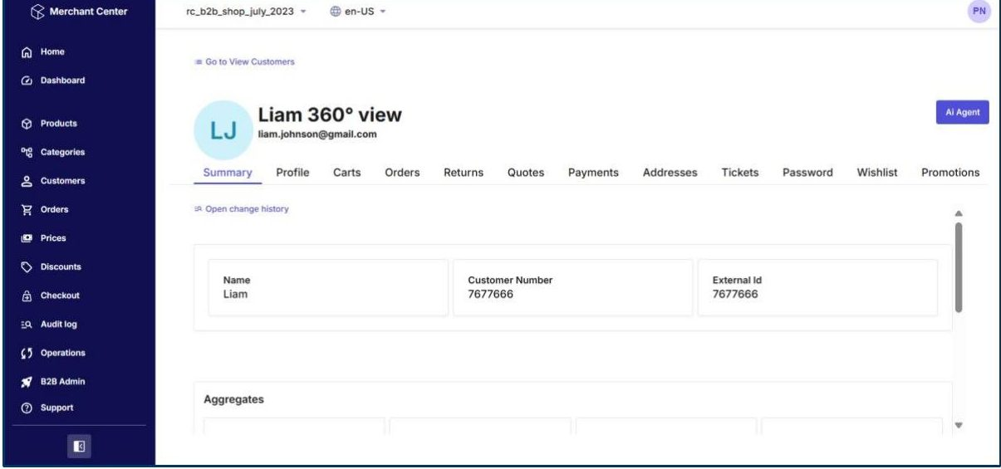
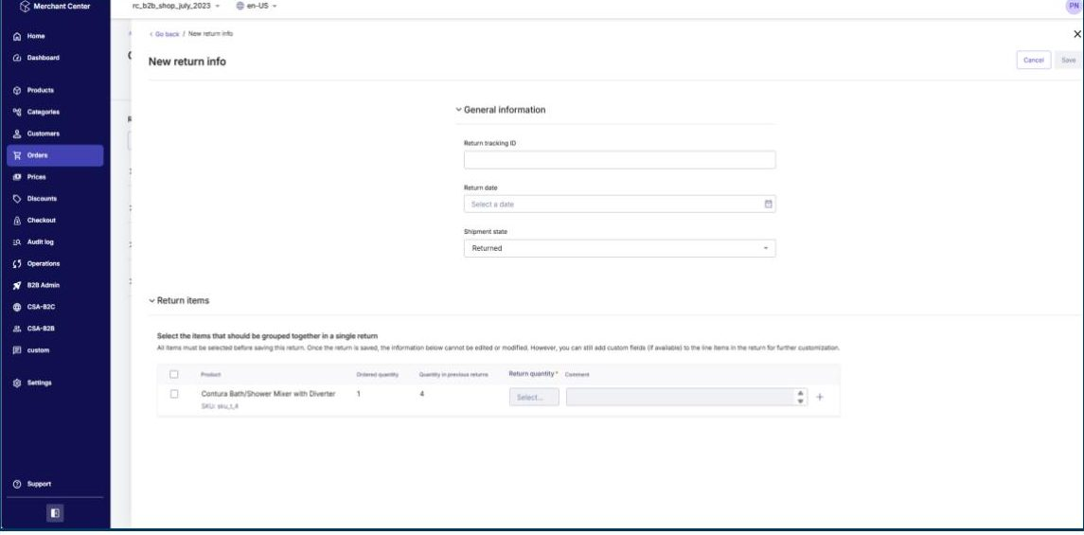
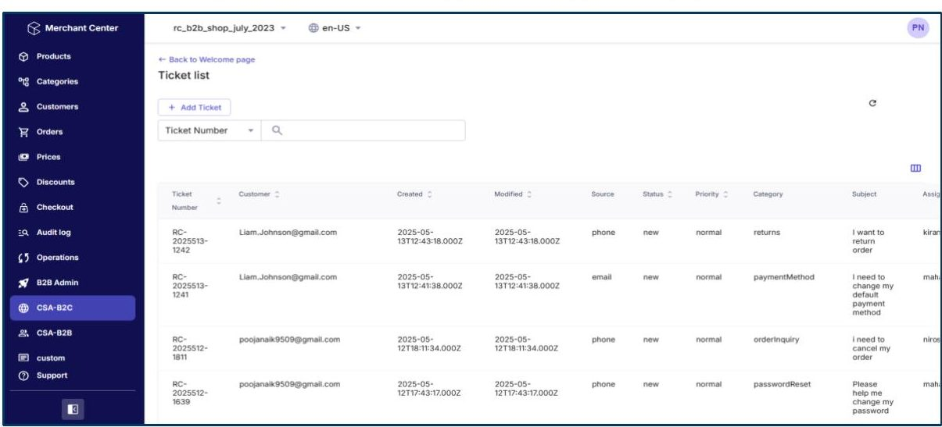
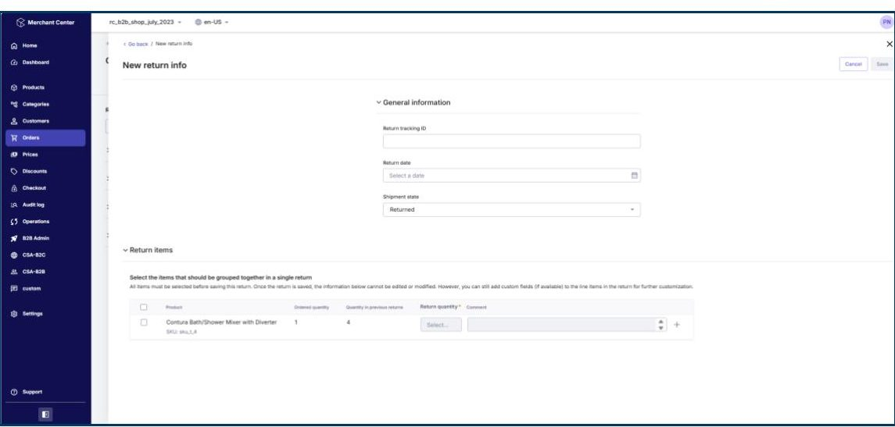
Merchant Center View
CSA Key Features
Customer 360° View
Order Management: Cancel, Return, Refund
Ticket Creation and Resolution
Product View & Real-Time Inventory
18
Copyright © 2026 Royal Cyber. All rights reserved.

Slide 16
MetaFyAI AI Visibility & Answer Engine Optimization
See how AI recommends your brand before buyers ever search. MetaFyAI measures, benchmarks, and improves how your brand appears across ChatGPT, Perplexity, Gemini, Google AI Overviews, and AI shopping assistants — the new answer economy.
Key Features
How It Helps Customers
1
Multi-Engine Visibility Intelligence
Track brand mentions, share of voice, and rank across every major AI engine and AI shopping assistant.
Win the shift from SEO to AEO
Stay discoverable as buyers move from search results to AI answers.
2
Competitive Benchmarking
Compare your presence by category, product line, and buying intent — see who AI recommends instead of you.
Protect brand & revenue
Catch invisible demand and stop competitors from being recommended in your place.
3
Citation Discovery
Scan sites, social, partner pages, and directories to surface where you're mentioned, inconsistent, or missing.
Fix visibility gaps
Correct product data, content structure, and source authority that keep strong brands invisible.
Agentic Feed Hub
Push AI-ready product feeds to AI, commerce, and social platforms with real-time pricing, inventory, and promo logic.
Always-fresh product data
Real-time feeds keep pricing, inventory, and promotions accurate across every AI channel.
4
AEO Content Optimization
Structure and enrich product data and content so AI engines can confidently find, understand, and cite you.
A clear 30-day action plan
Know exactly where you stand and what to do next to improve.
5
6
Local Visibility (GEO)
Geo-tagged content, location landing pages, and consistent directory mentions to win location-qualified AI searches.
19
Copyright © 2026 Royal Cyber. All rights reserved.

Slide 17
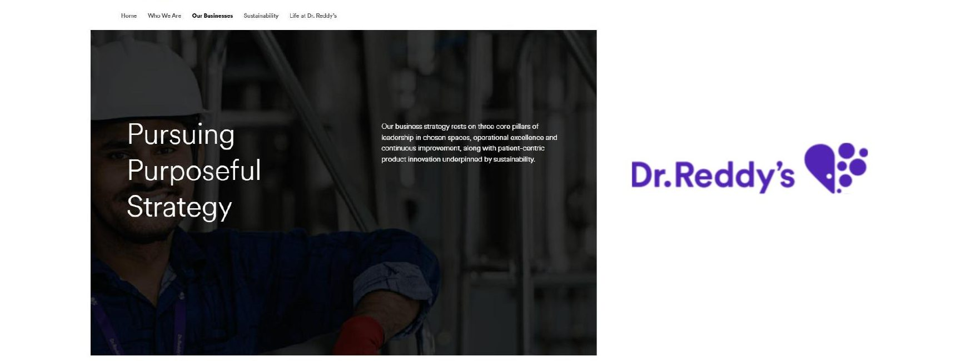
KEY FEATURES
Pharma Marketplace Enablement: Multi-vendor marketplace with RFQs, dynamic pricing, and order workflows across 10,000+ SKUs.
Dynamic Compliance Engine: Regulatory alerts and patent expiration tracking ensure compliance and sourcing restrictions across global markets.
Composable, Region-Aware: commercetools' headless framework supports multi-region deployment (US, EU, India) with role-based buyer access.
Dr. Reddy’s
Intelligent, Regulated, and Multi-Vendor Pharma Marketplace
Website: Dr. Reddy's Laboratories – Good Health Can't Wait
17
ROYAL CYBER × commercetools
Copyright © 2026 Royal Cyber. All rights reserved.
Notes:
For Dr. Reddy’s, Royal Cyber helped transform pharmaceutical procurement into a more efficient and compliant process. We built a multi-vendor marketplace that supports RFQs, dynamic pricing, and complex order workflows across more than 10,000 SKUs, streamlining operations for hospitals, pharmacies, and wholesalers. We also deployed a dynamic compliance engine to track regulatory alerts and patent expirations, ensuring sourcing meets global regulations. And with a composable, region-aware architecture, the platform delivers localized experiences and role-based access across the US, EU, and India​

Slide 18
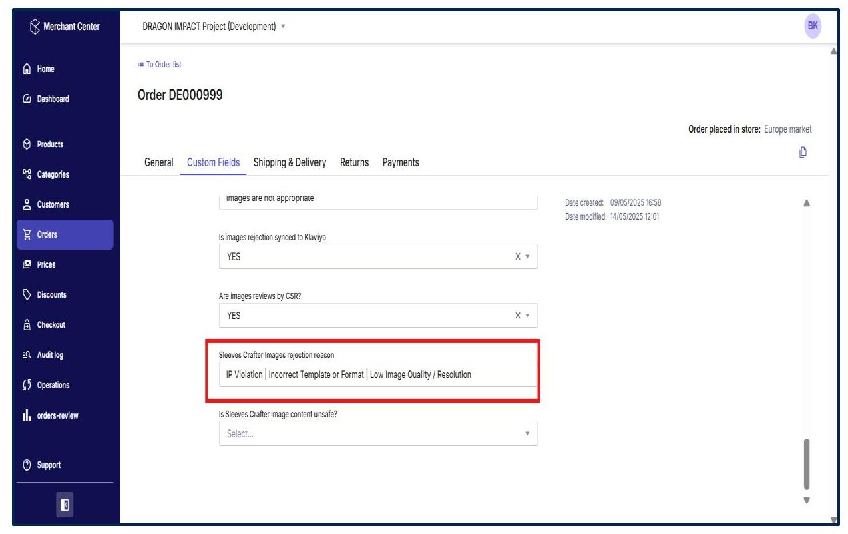
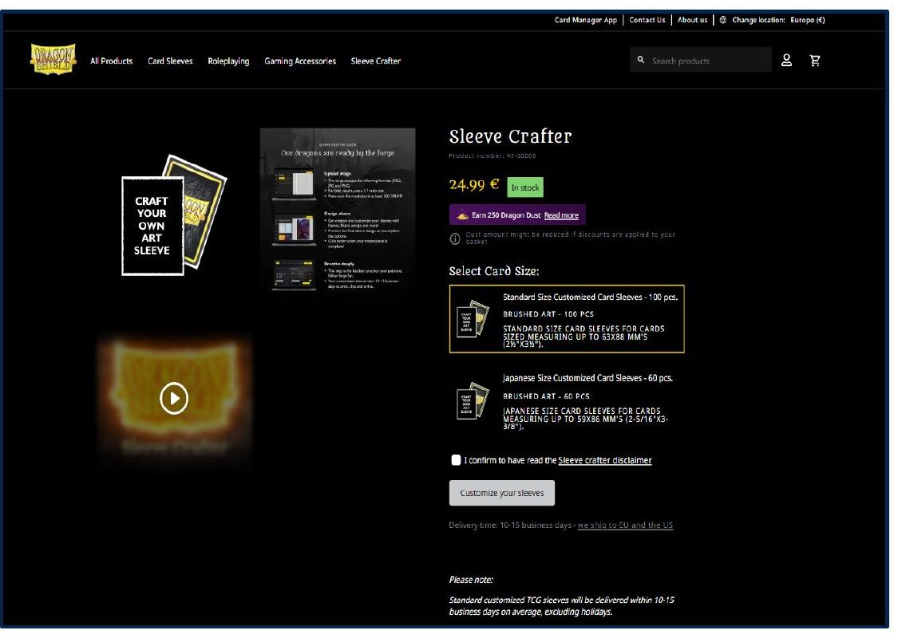
Dragon Shield Implemented Features
Custom CSR Workflow for Safe Image Moderation
Smarter Customization, Proactive Comms
16
Copyright © 2026 Royal Cyber. All rights reserved.

Slide 19
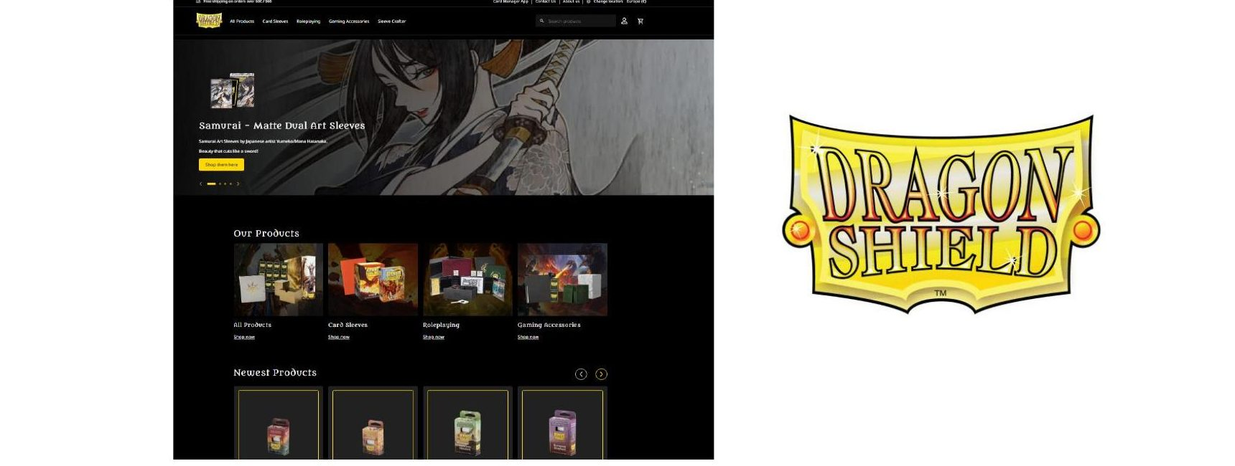
KEY FEATURES
Custom CSR Moderation: A commercetools Custom Application in the Merchant Center lets CSRs review user-uploaded images post-order, reducing IP risk.
Seamless System Integration: Maintained existing systems like Printess and HP Siteflow while adding new moderation capabilities.
Enhanced Communication: Automated email alerts for rejected uploads increase transparency and improve the user experience.
Dragon Shield
Secure, Scalable, and Seamlessly Personalized Commerce
Website: CSR Demo available on request
15
Copyright © 2026 Royal Cyber. All rights reserved.
Notes:
Dragon Shield is a premium brand known for producing high-quality card sleeves and accessories for trading card game enthusiasts.​
​
D2C​
​
For Dragon Shield, Royal Cyber helped streamline how user-generated content is managed. We built a custom CSR moderation workflow directly into the Merchant Center, so customer service reps can efficiently review post-order images, reducing legal and IP risks. At the same time, we integrated seamlessly with existing systems like Printess and HP Siteflow, adding new capabilities without disrupting operations. And to keep customers informed, we implemented automated email alerts for rejected uploads, improving transparency and the overall user experience.​

